Slide 1

Final Project: MortgCo Mortgage Refinance Predictions Based on Pennsylvania Census Data
Problem Statement: Pennsylvania residents who own property either own in full or finance their property through loans or mortgages.
How can we identify potential candidates for our mortgages by profiling potential or non-potential customers?
UCI Introduction to Data Science Fall 2019
Henry Sue
Image Source: 123rf.com stock images

Slide 2
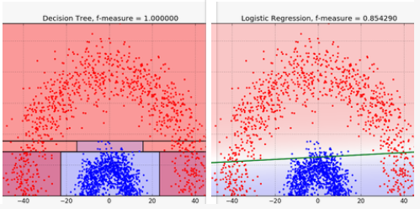
Constructing Model: Selecting model to approach how to classify profiles
In order to approach the business problem, we selected the decision tree model as it will be able to make informed judgments based on the most important criteria. We selected this model over a logistic regression because we are able to more accurately fit a profile based on how each variable interacts with each other.
For example, a family unit with a larger number of family members (larger NPF) may still opt for a mortgage despite having a larger Household Income (larger HINCP), whereas a family with 1 family member (lower NPF) who may have a lower Household Income (lower HINCP), may own property. Because there are many variables that make up how a person can be profiled, it is important to select a model that can sort data into groups of likeness.
Pictured: How a decision tree can more accurately group based on how variables interact with each other by grouping data into subsets of like characteristics
Image Source: BigML Blog
https://blog.bigml.com/2016/09/28/logistic-regression-versus-decision-trees/

Slide 3
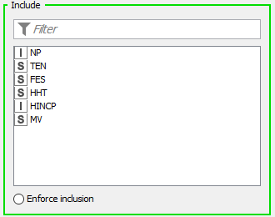
Model: Decision Tree Based on Key Variables
Variables Selected and Reasoning
NP: Number of Persons associated with this housing record | The larger the family unit, the more resources must be split, lower income per capita for the household.
FES: Family Type and Employment Status | Family units type (single vs married) and employment status can factor into the ability to afford full price of property.
HHT: Household Type | Household type can determine whether or not a person is in the stage to fully own a property or owning via mortgage or loan.
HINCP: Household Income (Binned by frequency, 7 bins) | Household income largely determines whether or not a household can afford the cost of fully owning a home or whether they will likely opt for a mortgage or loan.
MV: When moved into house | As time progresses, the larger chance that the homeowner will have either completely paid off property or owns the property.
TEN: Tenure, owned with mortgage vs owned free and without loans | This is the variable measured. The Tenure is categorized into two subsets, 1: Households that own their house with a mortgage or loan. 2: Households that own their homes free and clear.
Pictured: The variables that are input into our model, collected from Pennsylvania Census Data from 2012-2016.
Variables were selected due to possible correlation with mortgage choice and limited to 5 contributing variables.

Slide 4


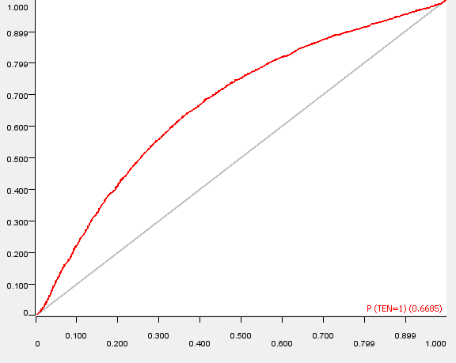
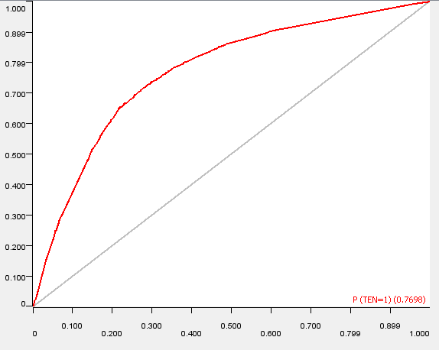
Comparison: Naïve model versus our predictive model
Naïve Solution: Prediction based on Household Income Only
Our Solution: Prediction based on multiple variables taken from census data
Confusion Matrix: Ten vs Ten(Predicted) Accuracy: 63.67%
Confusion Matrix: Ten vs Ten(Predicted) Accuracy: 72.075%
Area Under ROC Curve – 0.6685
Area Under ROC Curve – 0.7698

Slide 5
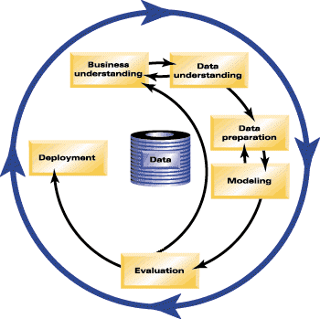
How CRISP-DM is applied to this business problem?
The business problem is introduced, and we apply our understanding of what factors may be important to profiling potential customers of MortgCo. We can use this extract critical variables to include into our model.
We prepared the data by assigning different variable types (integer vs string) to each variable based upon how the variable was stored, and represented a large range of values (Household income) by sorting each value as being part of a subset or “bin”.
The model was selected by evaluating what model would be valuable based on the spread of the data and what would give us the best answer to our customer profile. A decision tree model including 5 key variables was trained on 80% of a dataset and evaluated on the remained 20% of the dataset to check accuracy of the model.
Deployment remains based on decisions that MortgCo Executives may make based on our predictions and findings.
Image Source: IBM SPSS Support Resources, https://www.ibm.com/support/knowledgecenter

Slide 6
Conclusions
We created a model based on 5 key variables that are available from Pennsylvania Census Data:
NP: Number of Persons associated with this housing record
FES: Family Type and Employment Status
HHT: Household Type
HINCP: Household Income (Binned by frequency, 7 bins)
MV: When moved into house
TEN: Tenure, owned with mortgage vs owned free and without loans
This model proved to be approximately 72% accurate at predicting whether a person who owns property owns freely and clear or if the person owns through a mortage or loan.
This model is more accurate than guessing purely based on houshold income, which has a accuracy of approximately 63%.
Accuracy Statistics for Model
Accuracy: 72.075%
Error: 27.935%
Correct Classified: 20,191
Incorrectly Classified: 7,823
Cohen kappa (k): 0.423
Dataset: Pennsylvania Housing Census 2012-2016
Training Data / Evaluation: 80% / 20%
Root Evaluation of Decision Tree: FES, Family Type and Employment Status (1-8, Married / Unmarried, Employed / Unemployed)
Recommendation: We can leverage this model to begin marketing our mortgage options to those who currently own property through mortgage or loan, as well as market to those looking to own a home soon and match our profile for a user who will own with a mortgage or loan.

